Slide 1
Geographic Suitability Maps Using LSP
Cole MacLean
April 4, 2016

Slide 2


Slide 3

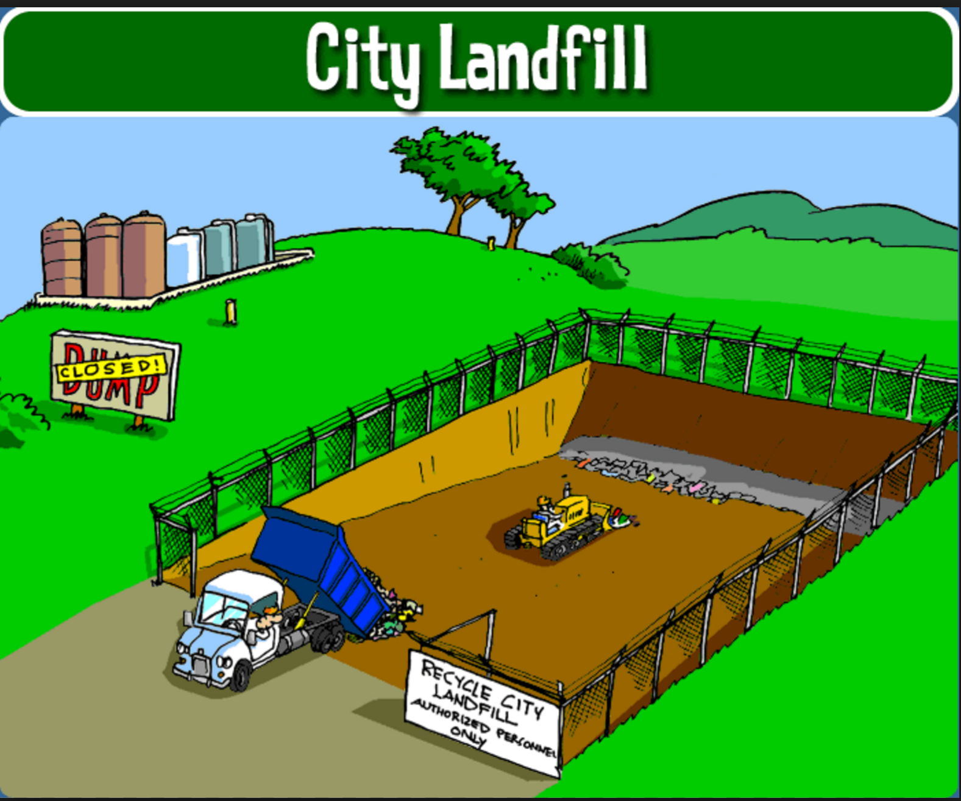



Slide 4
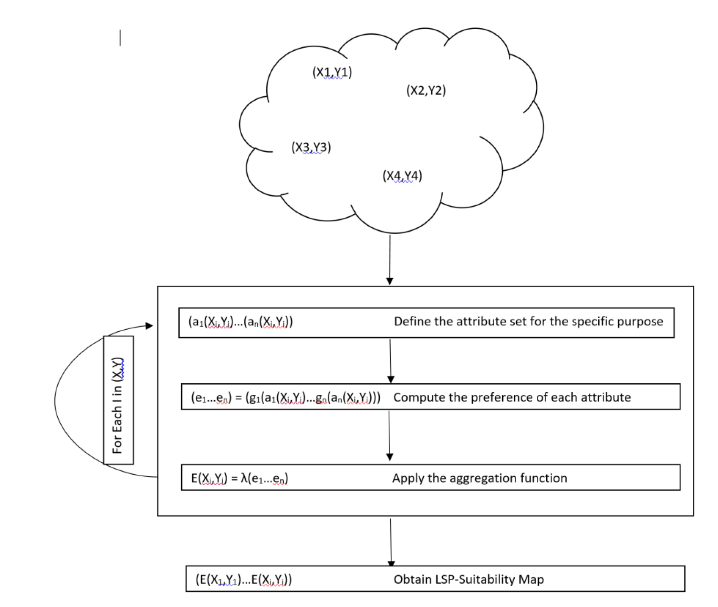
LSP (Land Suitability Potential) Methodology

Slide 5
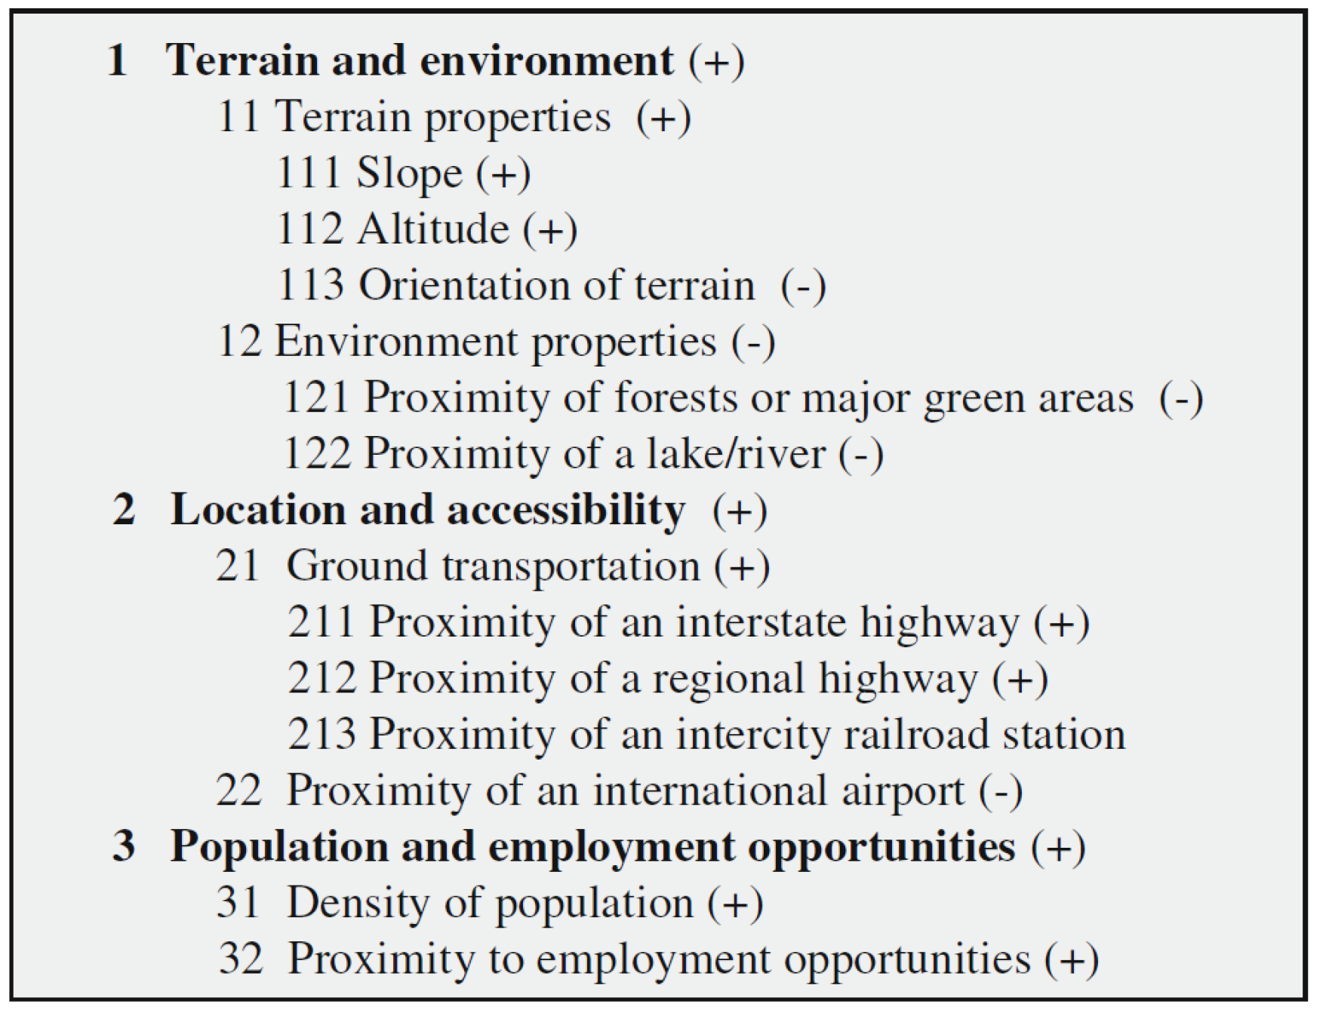
Attribute Selection

Slide 6
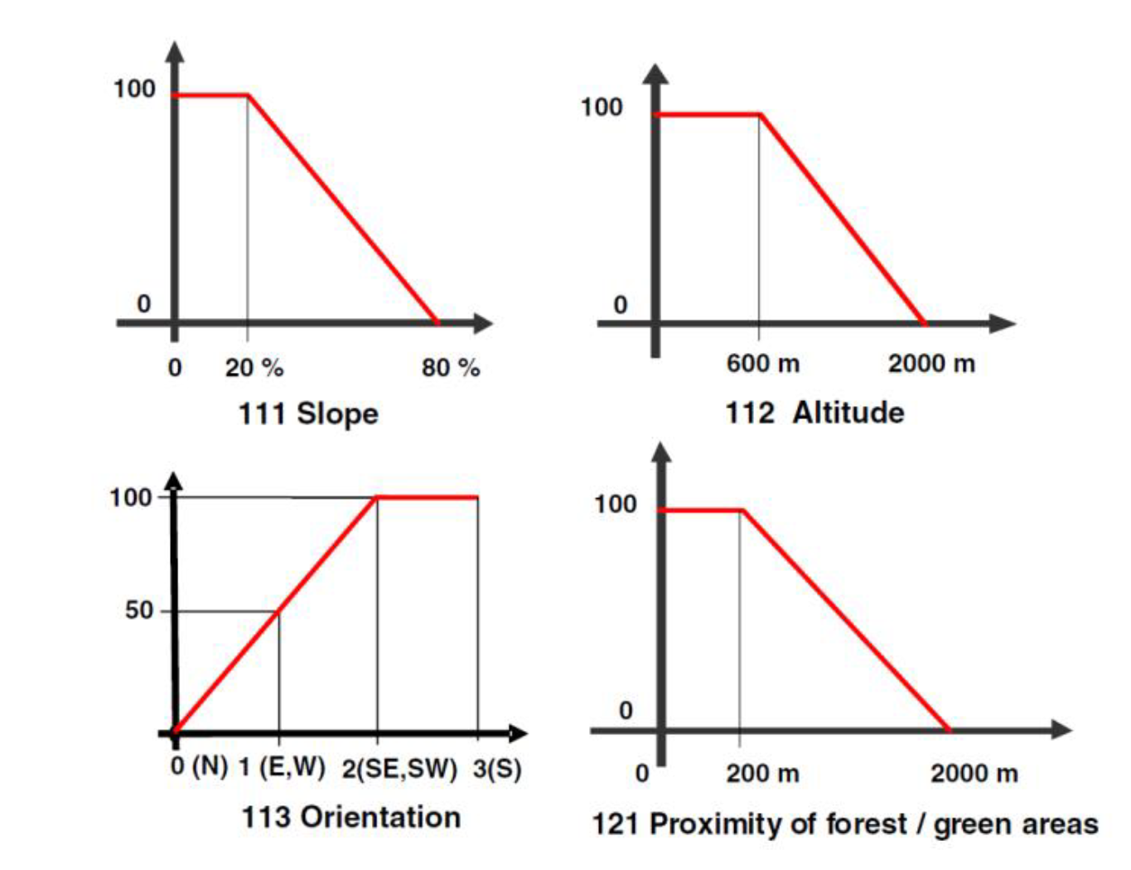
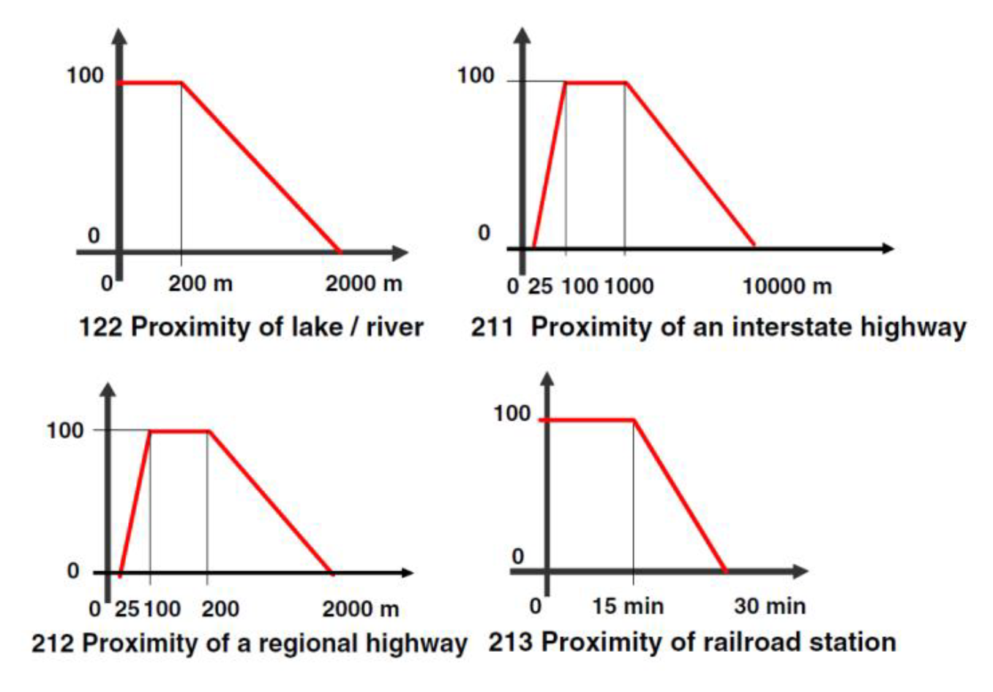
Suitability Functions

Slide 7
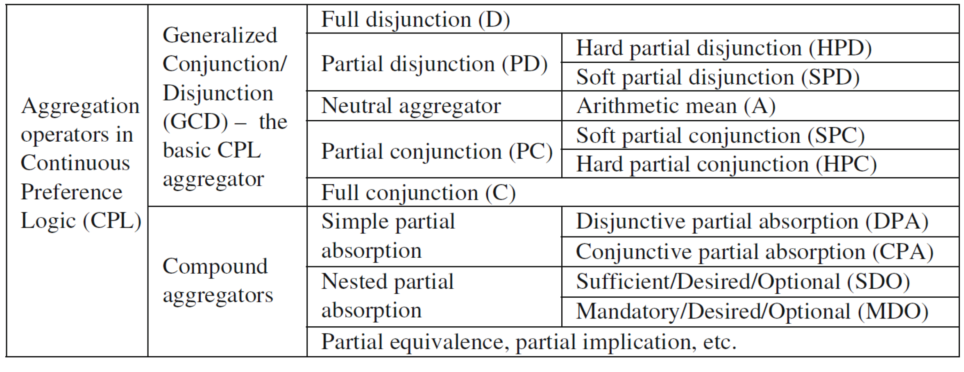
Aggregation

Slide 8
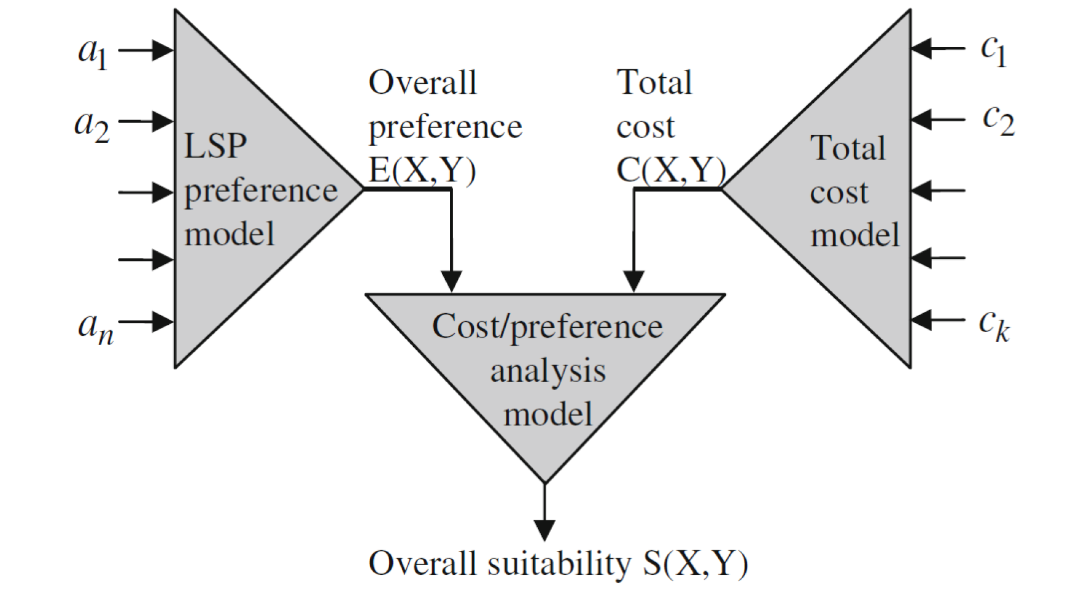
Other Considerations
Financial Costs
Data Gather and Quality
Defining the Search Space

Slide 9

SEAS

Slide 10
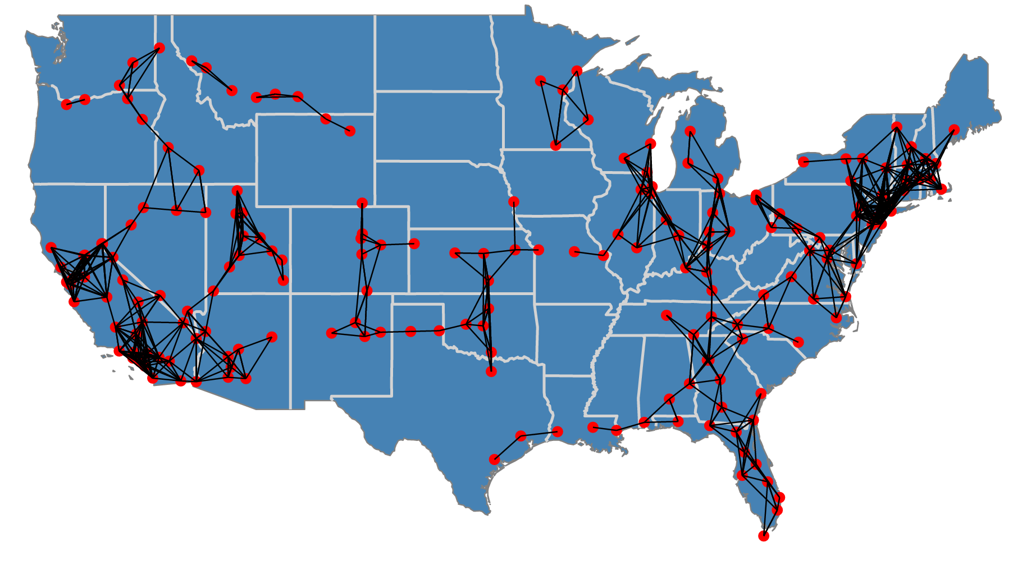
Tesla Super Chargers

Slide 11
Conclusions
LSP is a methodology for utilizing the general principles of MCDSS to a specific domain (ie. Geographical problems)
Broad range of applications
Socially important impact
Interesting and challenging opportunities

